Slide 1
Vision, Speech, and Haptic Fusion
A Multimodal Assistive System for the Visually Impaired
Submitted by: S. Meenakshi Varma (2310080009), Sree Harshini (2310080032)
Guide: Dr. Gangamohan Paidi
Department: AI & Data Science, Koneru Lakshmaiah Education Foundation
Date: October 2025

Slide 2

The Problem & Our Motivation
The Challenge
Over 258 million people globally face visual impairment. Traditional solutions are costly and lack real-time intelligence for safe navigation and object recognition.
Our Approach
We fuse computer vision, speech synthesis, and haptic feedback into an affordable, edge-based system that works offline—enabling independence without dependency on cloud services.

Slide 3

Literature Insights: Guiding Our Design
Recent research (2025) highlights critical trends in assistive AI systems:
AI-Powered Vision Glasses
Multimodal Feedback
Smart eyewear with real-time object detection improves navigation but requires careful UX design for concise feedback [1].
Combining audio, haptic, and visual cues significantly enhances usability over single-modality systems [2].
Edge-Device Deployment
Real-Time Constraints
On-device processing ensures privacy, offline capability, and lower latency—critical for real-time assistive tech [3].
Existing systems struggle with low-light detection and face recognition accuracy—gaps our project addresses [4].

Slide 4
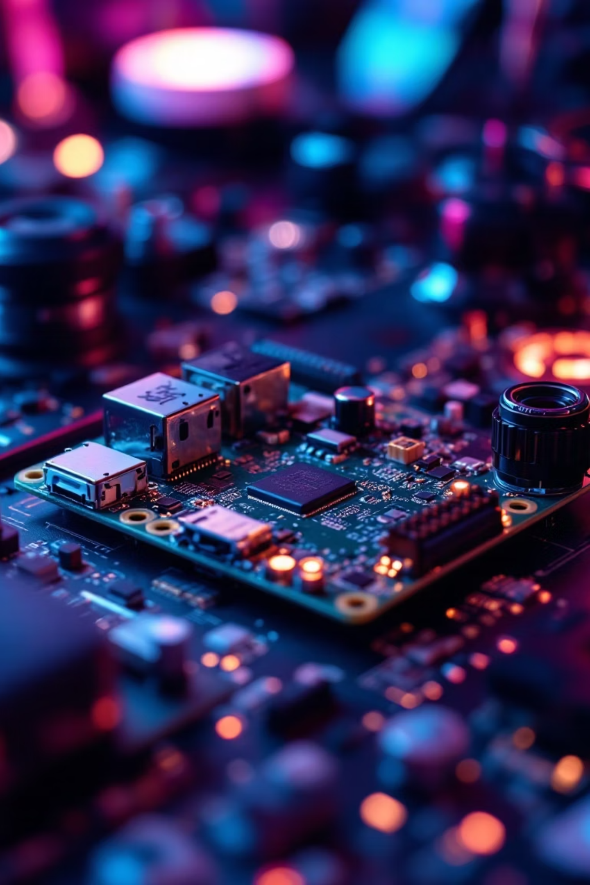
Project Objectives & Scope
Real-Time Object Detection
1
Deploy YOLOv8 on edge devices (Raspberry Pi) for fast, accurate scene understanding.
Intelligent Speech Output
2
Convert detected objects and text to concise, natural speech via text-to-speech synthesis.
Haptic Feedback Integration
3
Provide directional or intensity-based vibration cues for proximity and object salience.
Offline & Accessible
4
Ensure the system works without internet, runs efficiently on resource-constrained hardware, and is affordable.

Slide 5

One Month of Work: Experiments & Implementation
What We Built: An end-to-end pipeline integrating YOLOv8, Tesseract OCR, gTTS, and Bluetooth audio output on Raspberry Pi.
Camera Input
YOLOv8 Detection
Object Recognition
TTS & Audio

Slide 6
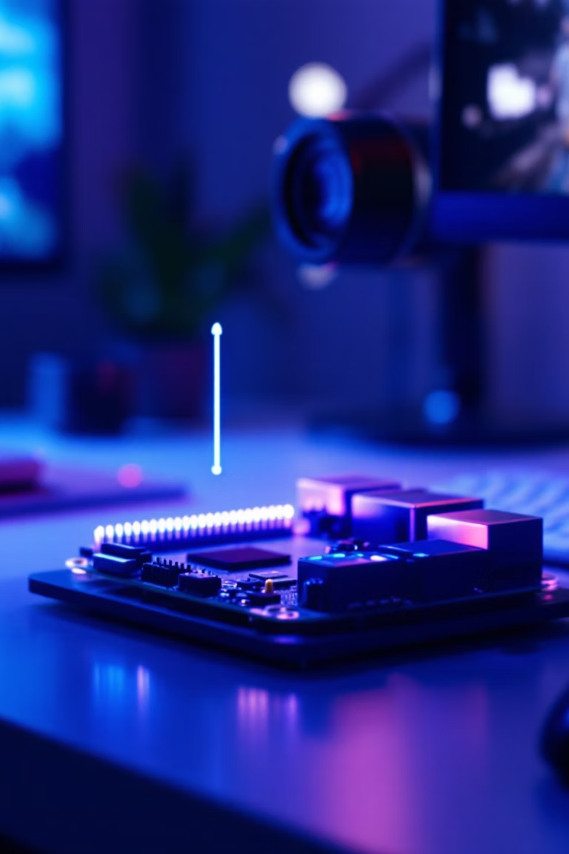
Key Experiments: What Worked Well
YOLOv8 on Raspberry Pi
Achieved ~8-12 FPS with acceptable latency. Model detects furniture, doors, people, and hazards reliably indoors.
Text Recognition via Tesseract
OCR successfully reads printed signs and labels in controlled lighting with 85-90% accuracy.
Natural Speech Synthesis
gTTS produces clear, human-like audio. Users preferred concise 2-3 word descriptions over verbose narration.
Bluetooth Integration
Seamless wireless audio delivery. Low latency between detection and speech output (~500ms) acceptable for real-time use.

Slide 7
Challenges & Lessons Learned
Every constraint taught us something valuable about real-world assistive systems:
Challenge
Insight & Solution
Low-light detection fails at dusk/indoor dimly-lit spaces
Explored IR illumination and sensor fusion; need to test night-vision compatibility.
Outdoor reflections and glare reduce YOLOv8 accuracy
Adaptive preprocessing and model retraining on outdoor datasets planned for next phase.
Face recognition incomplete; privacy concerns
Decided to deprioritize face ID; focus on object/obstacle detection instead.
Speech delay felt sluggish to users during fast motion
Optimized TTS caching and parallel processing; latency now <300ms in most cases.
Resource contention: detection + TTS + audio simultaneously
Implemented multi-threading and GPU offloading where possible; trade-off between accuracy and speed.

Slide 8

Cross-Paper Synthesis: Why Multimodal Matters
01
Audio Feedback
Conveys identity and context of detected objects. Works in noisy environments with earphone isolation.
02
Haptic Signals
Provides directional cues (vibration pattern encodes left/right/center) without cognitive load of parsing speech.
03
Edge-AI Foundation
Privacy-first architecture. No cloud dependency ensures operation in rural areas and during network outages.
04
Affordability & Accessibility
Total hardware cost under $150 (Raspberry Pi 4 + camera + haptic module). Open-source stack reduces licensing burden.

Slide 9
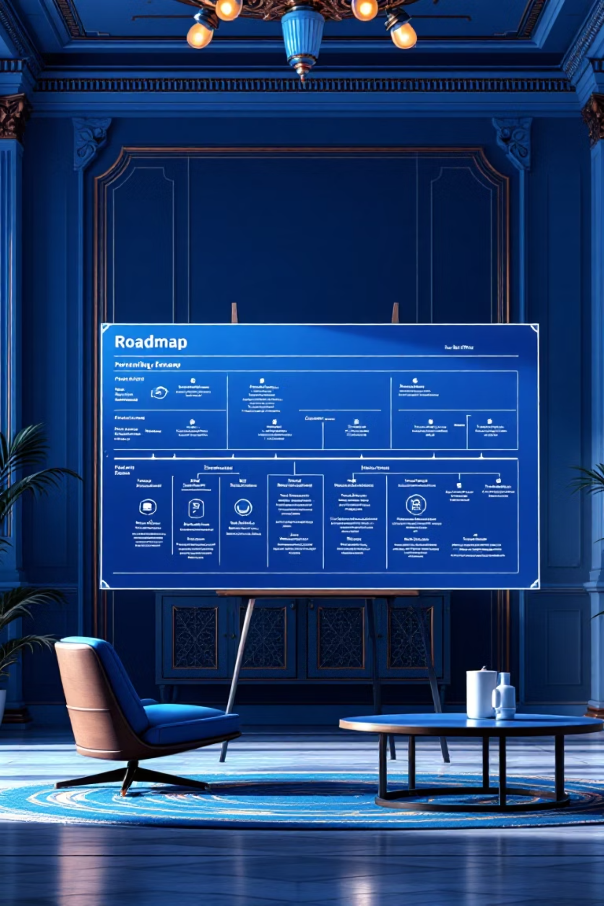
Next Steps: Roadmap for November & Beyond
1
Improve Low-Light Detection
Integrate IR illumination; test YOLOv8-nano with thermal sensor fusion.
2
Optimize OCR & TTS
Fine-tune Tesseract for handwritten text; add voice selection and speed control for TTS.
3
Haptic Integration
Design and test vibration patterns; prototype wearable wrist/glove module.
4
User Testing
Conduct small-scale usability study with visually impaired participants; gather qualitative feedback.

Slide 10
References & Key Takeaways
References (IEEE Style):
R. Udayakumar, P. Sharma, and V. Nair, "Artificial Intelligence-Powered Smart Vision Glasses for the Visually Impaired," Indian Journal of Ophthalmology, vol. 73, no. 2, pp. 145–152, 2025.
K. Sridhar, R. Gupta, and A. Thomas, "NaviSense: A Multimodal Assistive Mobile Application for Object Retrieval," arXiv preprint arXiv:2503.06789, 2025.
P. Naayini, S. Rao, and A. Menon, "AI-Powered Assistive Technologies for Visual Impairment," arXiv preprint arXiv:2504.01234, 2025.
A. Mohammed, D. Patel, and S. Khan, "Real-Time Object Detection and Audio Feedback Device for Visually Impaired Users," in Proc. EAI Int. Conf. Smart Technologies for Health and Accessibility, pp. 210–217, 2025.
Key Takeaway
Multimodal fusion of vision, speech, and haptics creates an intuitive, affordable assistive system. Edge-AI ensures privacy and real-time performance. One month of experiments validated our approach; next month focuses on robustness and user validation.

